Slide 1
Big Mountain Resort - New Ticket Price
By - Anshul Malhotra

Slide 2
Problem
Big Mountain was not able to make enough profit
New lift was installed with additional operating cost of $1,540,000

Slide 3
What to can be done ?
Change ticket price
Finding out what facilities matter most to visitors and for which they can pay more

Slide 4
Important Features found by Model
vertical_drop - Vertical Drop from height
Snow Making_ac - Snow Making area
total_chairs - Total chairs operated
fastQuads - Fast quads
Runs - Number of runs
LongestRun_mi - Longest Run
trams - Trams
SkiableTerrain_ac - Skiable area

Slide 5
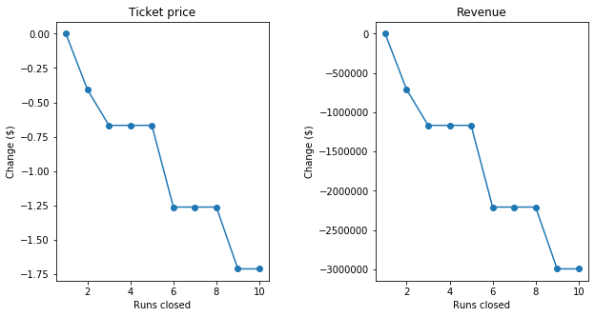
Don’t close 10 least used runs

Slide 6
Facilities with no effect
Increasing the longest run or increasing snow coverage

Slide 7
Recommendations
Increasing the vertical drop by 150 feet, and installing an additional chair lift.
It will support increase in ticket price by $1.99 Over the season, this could be expected to amount to $3474638.

Slide 8
Conclusion
Model shows adding an additional run and installing an additional chairlift to increase the 150 feet is the best option.
The increase in revenue from the change in ticket price will make up for the additional chair lift and more.

